Slide 1

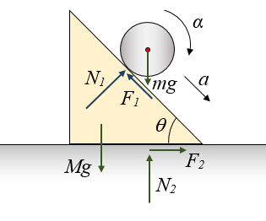

Angry Santa GPU Snowball Simulation
Focus: physically simulate a snowball rolling downhill, growing in mass by collecting snow particles from terrain (stochastic process)
Key Components:
- Pseudo-realistic downhill motion (gravity, friction…)
- Large-scale snowfield with thousands of particles
- Parallel snow accumulation and terrain interaction
- Real-time rendering (OpenGL)
Core simulation is dominated by highly parallel particle processing
GPU Programming 2025-26 - POLITO
Grisotto Maurizio S336145

Slide 2
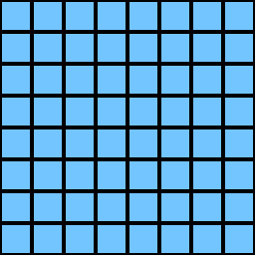

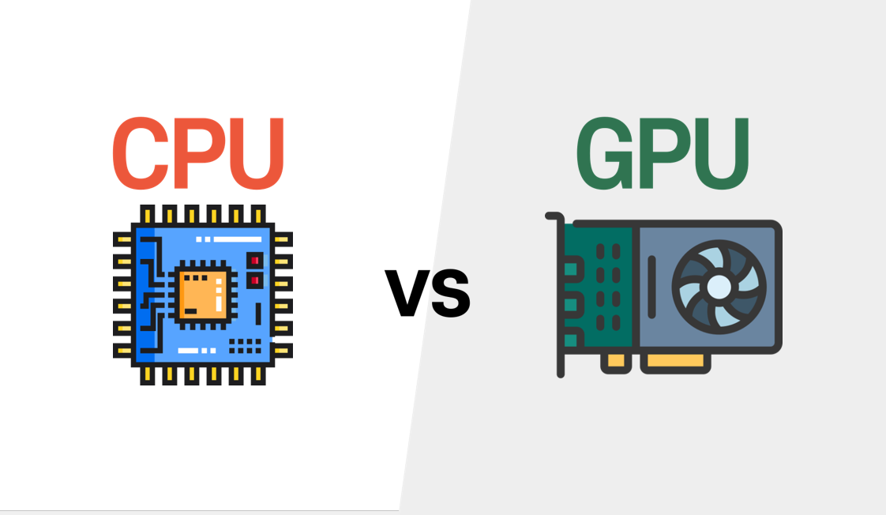
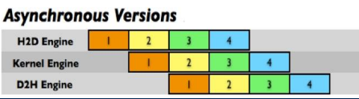
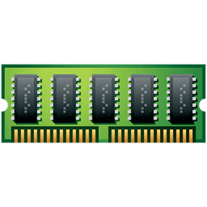


GPU Leverage
1. Particle accumulation is massively parallel:
- Each particle independently checks if it is absorbed by the ball
2. Real-time physics updates:
- Requires parallel reductions and atomic operations
3. Strong CPU vs GPU performance difference:
- CPU: sequential → O(n) per timestep
- GPU: thousands of threads → huge speedup
4. CUDA Streams & Events:
- Enables optimized multi-kernel pipeline
5. Memory Optimization:
- Shared and Coalescing Memory, Occupancy, Reductions
6. Multi-GPU scalability:
- Allows near-linear scaling for very large particle counts
GPU Programming 2025-26 - POLITO
Grisotto Maurizio S336145

